Slide 1

Bank of Baroda Hackathon 2024
Financial Advisory - WealthWise
Your Team Name : Quintessential Programmers
Your team bio : Combining expertise in finance and AI, driven by a passion for democratizing access to personalized financial advice.
Date : 29/06/2024

Slide 2
Problem Statement
The financial advisory industry is ripe for innovation, facing persistent challenges in efficiency, scalability, and personalization. Traditional models struggle to keep up with the growing demand for personalized financial advice and efficient service delivery.
Artificial intelligence (AI) presents a unique opportunity to address these challenges by automating routine tasks, providing data-driven insights, and enhancing client engagement. According to Accenture, AI has the potential to increase profitability in financial services by 38% by 2035, and SmartAsset projects that AI-driven advisors will manage over $1 trillion in assets by 2025.
Despite the potential benefits, the integration of AI into financial advisory services is fraught with obstacles. These include concerns over data privacy and security, the complexity of technological integration, and the need to maintain the personalized human touch that clients value.

Slide 3
Pre-Requisite
What are the alternatives/competitive products for the problem you are solving?
Betterment:
Features: Automated portfolio management, goal-based investing, tax-loss harvesting.
Strengths: User-friendly interface, low fees, personalized advice based on risk tolerance.
Weaknesses: Limited human advisor interaction, generic advice algorithms.
Wealthfront:
Features: Automated investment management, financial planning tools, direct indexing.
Strengths: Comprehensive financial planning, tax optimization, cash management services.
Weaknesses: Lack of real-time advisory, limited customization options.

Slide 4
Tools or resources
Generative AI Models: Azure OpenAI (GPT-4) for generating personalized advice.
Data Analysis Tools: Python for data processing and analysis, Pandas, NumPy for data manipulation.
Financial APIs: Real-time market data APIs (e.g., Alpha Vantage, IEX Cloud).
Cloud Platforms: Azure for scalable cloud infrastructure.
Security Tools: Encryption technologies, secure access protocols (OAuth, multi-factor authentication).
Web Scraping Tools: BeautifulSoup, Scrapy for collecting data from financial advisory websites.
Word Embeddings: Azure Cognitive Services for processing textual data.

Slide 5
Any Supporting Functional Documents
Data Collection:
Customer Data: Collect financial data from users.
Market Data: Use financial APIs to get real-time data.
Scraped Data: Use web scraping tools to gather insights from financial advisory websites.
Data Processing: Clean and analyze data using Pandas and NumPy.
Word Embeddings: Process textual data from scraped sites using Azure Cognitive Services.
Model Training: Train generative AI models using Azure OpenAI.
Recommendation Engine:
Generate personalized investment strategies.
Leverage insights from scraped data to enhance recommendations.
User Interface:
Develop interactive dashboards.
Implement real-time advisory chatbots using Azure Bot Service.
Feedback Loop: Continuously improve the model based on user interactions and new data.

Slide 6
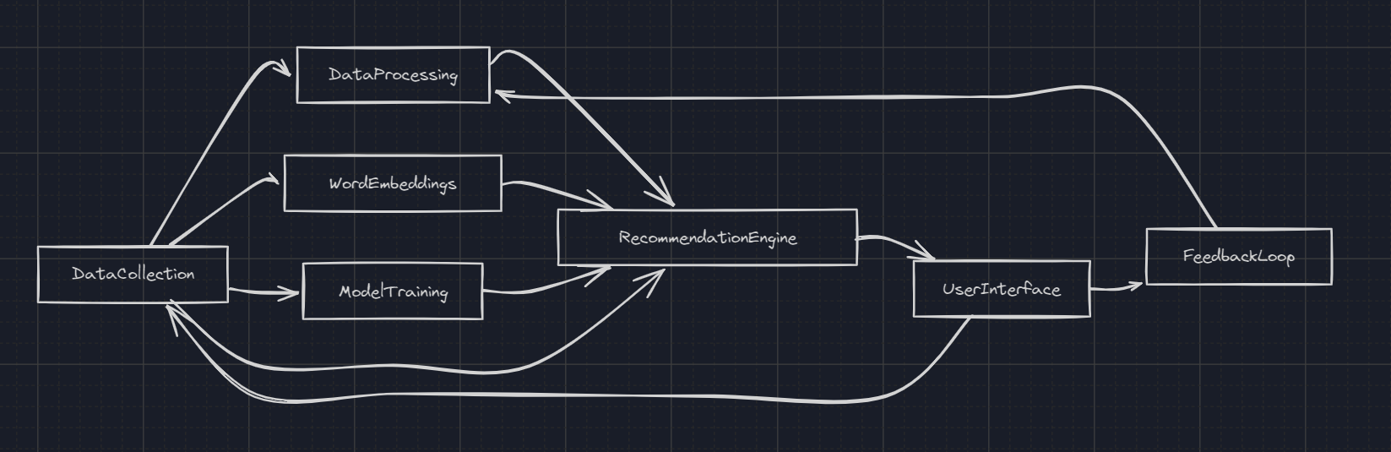
Any Supporting Functional Documents

Slide 7
Key Differentiators & Adoption Plan
Key Differentiators:
Personalization: Tailored investment advice based on individual financial profiles.
Real-Time Advisory: Adaptive strategies based on changing financial conditions.
Transparency: Clear explanations of AI-driven recommendations.
Adoption Plan:
Phase 1: Pilot with a small user group.
Phase 2: Iterate based on feedback and expand to a broader audience.
Phase 3: Full-scale deployment with continuous updates.

Slide 8
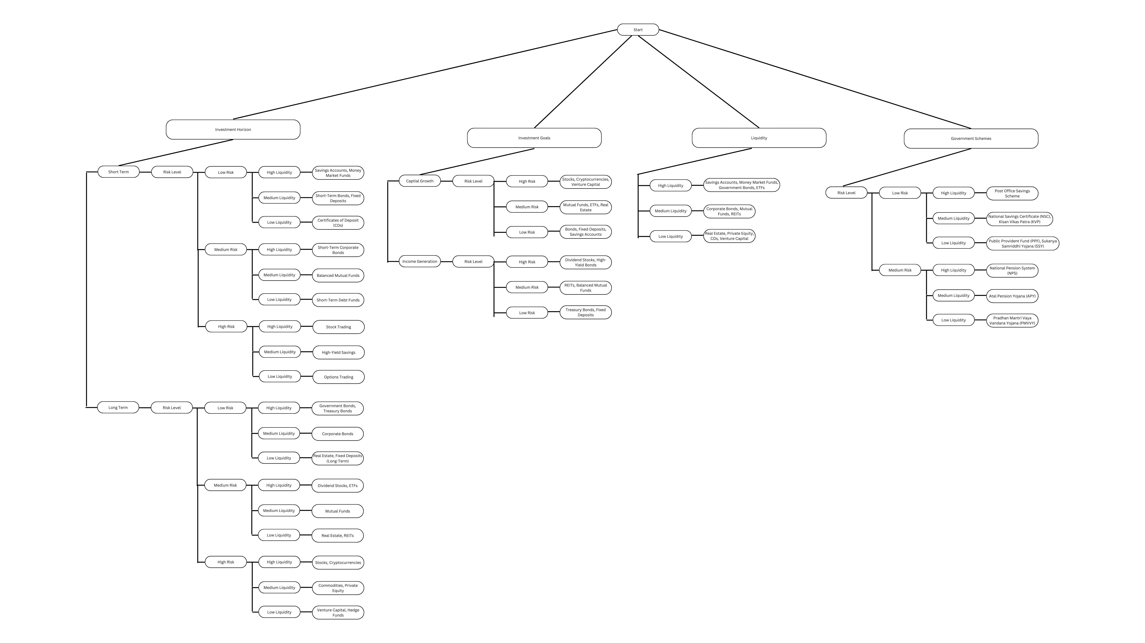
GitHub Repository Link & supporting diagrams, screenshot
Github Link - https://github.com/AbhishekNair050/WealthWise
This is the questionnaire that we have prepared which will help us decide the users financial preferences and what financial plan would be the best for them which would help us with making a detailed tailored plan just for them.

Slide 9
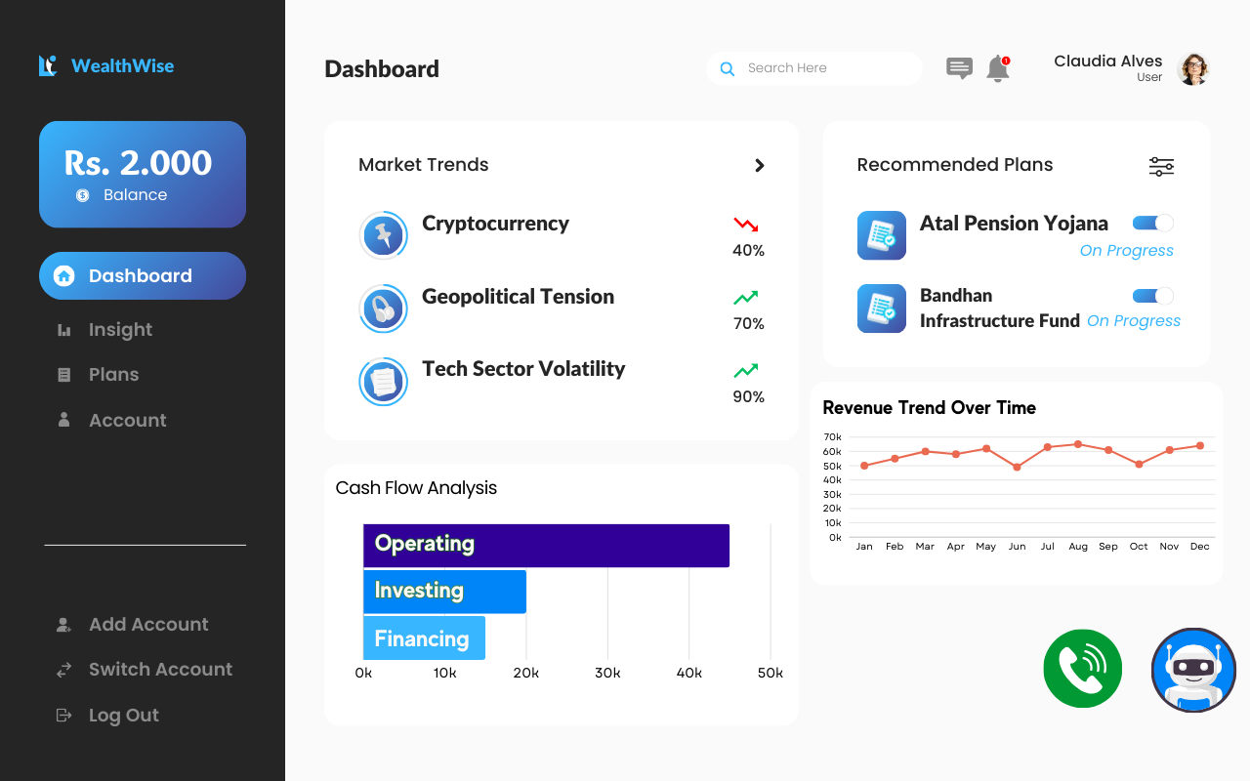
GitHub Repository Link & supporting diagrams, screenshot
Proposed Dashboard UI

Slide 10
Business Potential and Relevance
• Market Opportunity:
Growing demand for personalized financial advice
Shift towards digital-first financial services
Increasing need for AI-driven solutions in the fintech sector
Rising interest in sustainable and ethical investing
• Revenue Streams:
Subscription-based model
Premium advisory services
Data monetization through anonymized trend reports
Licensing of AI technology to other financial institutions

Slide 11
Business Potential and Relevance
• Competitive Advantage:
Use of advanced AI and real-time data analysis
Integration of traditional financial wisdom with cutting-edge technology
Ability to offer hyper-personalized advice at scale
Continuous improvement through machine learning algorithms

Slide 12
Uniqueness of Approach and Solution
Generative AI: Use of Azure OpenAI for sophisticated, personalized advice
Data Integration: Combining customer data, market data, and insights from financial advisory websites
Explainability: Ensuring users understand the rationale behind recommendations
Adaptive Learning: AI models that evolve based on market trends and user feedback
Holistic Financial Planning: Considering multiple aspects of a user's financial life simultaneously

Slide 13
User Experience
User-Friendly Interface: Intuitive dashboards and chatbots
Personalized Insights: Tailored recommendations based on individual needs
Continuous Engagement: Regular updates and real-time advisory services
Gamification Elements: Encouraging user engagement through goal-setting and achievement tracking
Multi-platform Accessibility: Seamless experience across web, mobile, and voice-assisted devices

Slide 14
Scalability
Cloud-Based Infrastructure: Use of Azure ensures scalability
Modular Design: Easy to add new features and data sources
Global Reach: Ability to serve users across different geographies
Microservices Architecture: Allowing independent scaling of different system components
Load Balancing: Efficient distribution of computational resources during peak usage times

Slide 15
Ease of Deployment and Maintenance
Azure Integration: Simplifies deployment and management
Automated Updates: Regular improvements to AI models and services
Comprehensive Support: Azure support services for troubleshooting and maintenance
Containerization: Use of Docker for consistent deployment across environments
CI/CD Pipeline: Automated testing and deployment for rapid iterations and updates

Slide 16
Security Considerations
Data Encryption: Ensuring data privacy and security
Access Controls: Role-based access to sensitive data
Compliance: Adhering to financial regulations and standards
Regular Security Audits: Proactive identification and mitigation of potential vulnerabilities
Secure Multi-tenancy: Ensuring data isolation for different users or partner institutions

Slide 17
Thank You
Team Members -
Priyanshi Furiya
Abhishek Nair

